Slide 1
AWS Basics
Introduction to Amazon Web Services

Slide 2
Agenda
Why an AWS talk?
From selling books to selling bytes – The Story of AWS
AWS – Run through of site and console
AWS – Key Products and Services
Building a Static Website: Route 53 and S3
Mini-AWS - Lightsail

Slide 3
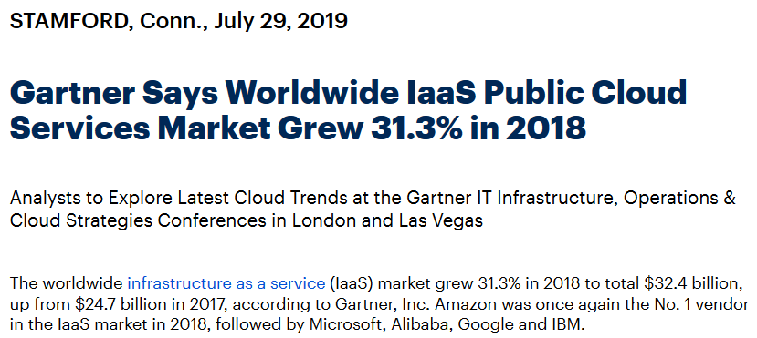
Why a AWS talk?
$32.4 billion
AWS No. 1
* https://www.gartner.com/en/newsroom/press-releases/2019-07-29-gartner-says-worldwide-iaas-public-cloud-services-market-grew-31point3-percent-in-2018

Slide 4
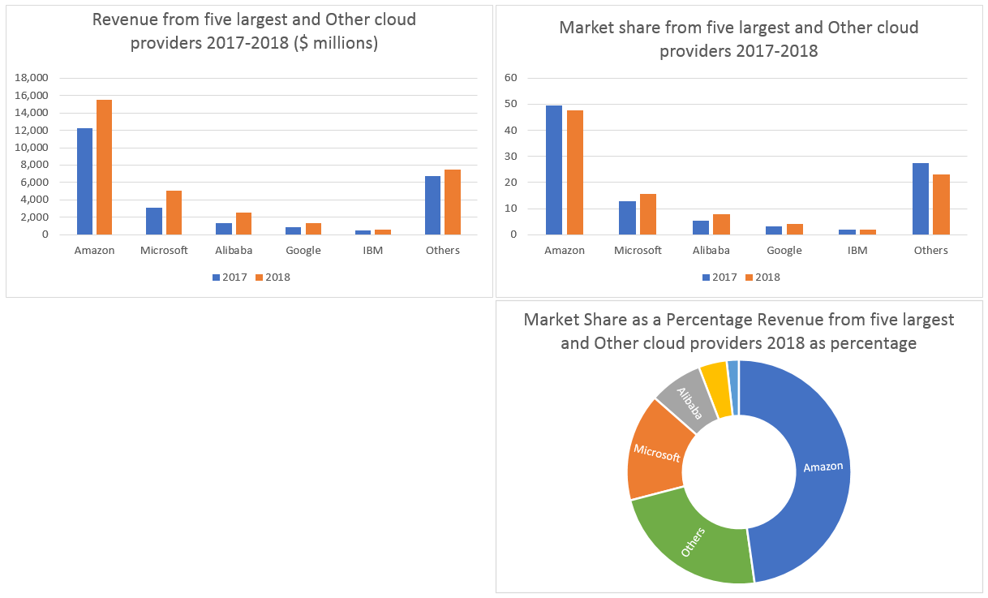
Cloud 2019
Total $32.4 billion
Amazon $15.5 billion

Slide 5



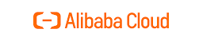

Other Clouds
We will look to do the others

Slide 6
Why a AWS Talk?
Cloud computing skills are in demand (Linkedin, 2019)
1. Cloud Computing
2. Artificial Intelligence
3. Analytical Reasoning
4. People Management
5. UX Design
* https://www.gartner.com/en/newsroom/press-releases/2019-07-29-gartner-says-worldwide-iaas-public-cloud-services-market-grew-31point3-percent-in-2018

Slide 7
From selling books to selling bytes – The Story of Amazon and AWS
May 1994 – Jeff Bezos leaves D E Shaw & Co as VP to launch online commerce business
July 5 1994 – Jeff Bezos incorporates Amazon.com
July 1995 – Amazon starts selling books on line
July 1996 – Amazon creates ‘Associates Program’
May 15 1997 – Amazon goes public trading on NASDAQ AMZN
July 2002 – “Amazon Web Services (AWS)” offers first web service to access Amazon’s web catalogue
2004 – AWS announced as a services Amazon where looking to offer
November 2004 – AWS launches Simple Queueing Service (SQS)
March 19 2006 – AWS launches Simple Storage Service (S3)
August 24 2006 – AWS launches Elastic Compute Cloud (EC2)*
2009 – AWS launches Virtual Private Cloud (VPC)
2013 – AWS certification Launched
1. *Announcing Amazon Elastic Compute Cloud (Amazon EC2) – beta https://aws.amazon.com/about-aws/whats-new/2006/08/24/announcing-amazon-elastic-compute-cloud-amazon-ec2---beta/

Slide 8
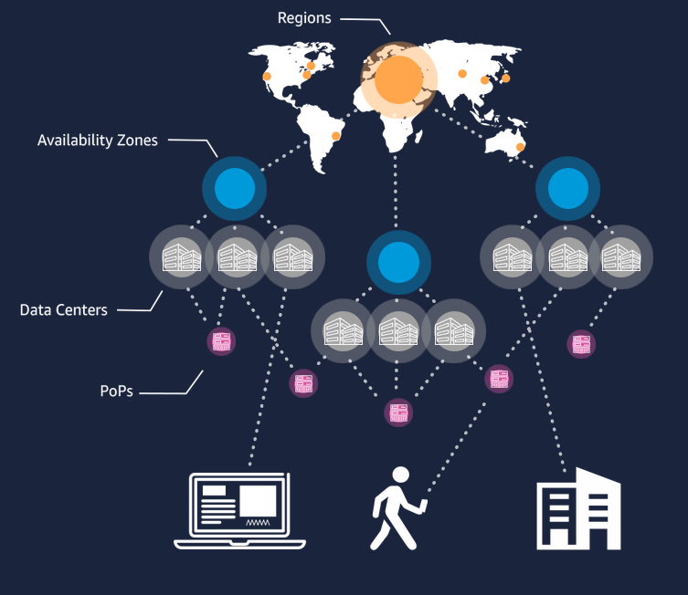
AWS Infrastructure
Regions – Connected AZs in close geography
Availability Zones (AZ) – collected Data Centers
Data Center (DC) – Servers, power
Points of Presence (PoPs) – CloudFront CDN

Slide 9
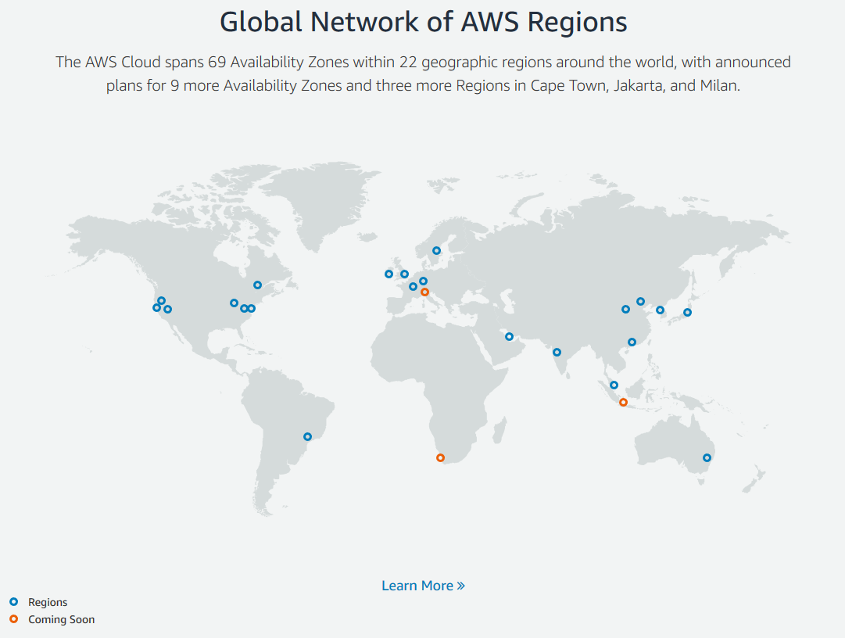
AWS – Cloud Setup
22 Geographic Regions
69 Availability Zones (AZ)
https://www.infrastructure.aws/

Slide 10
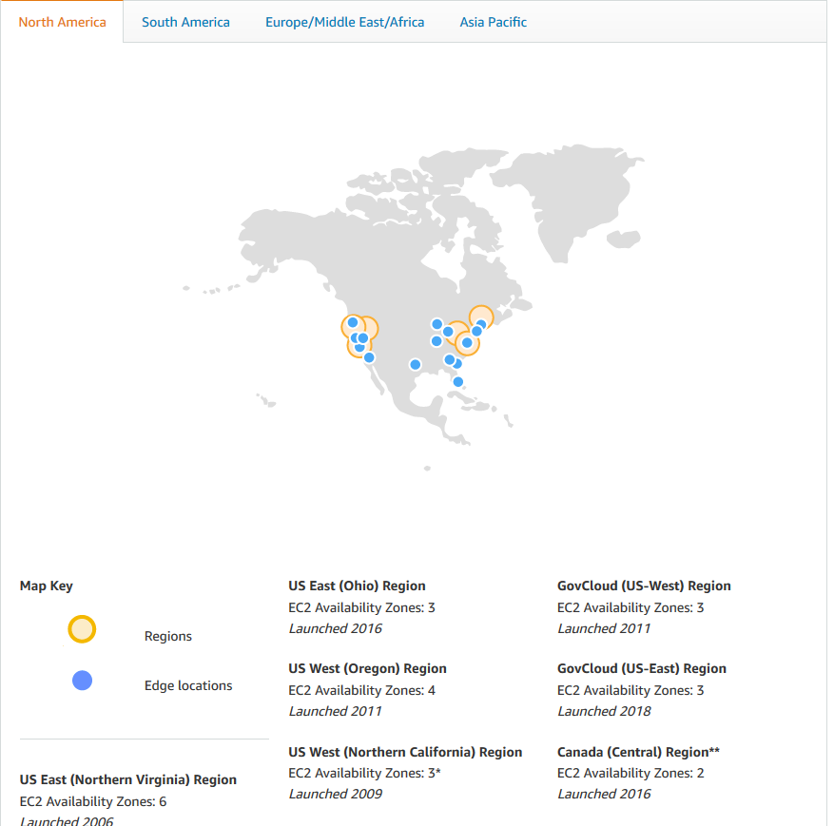
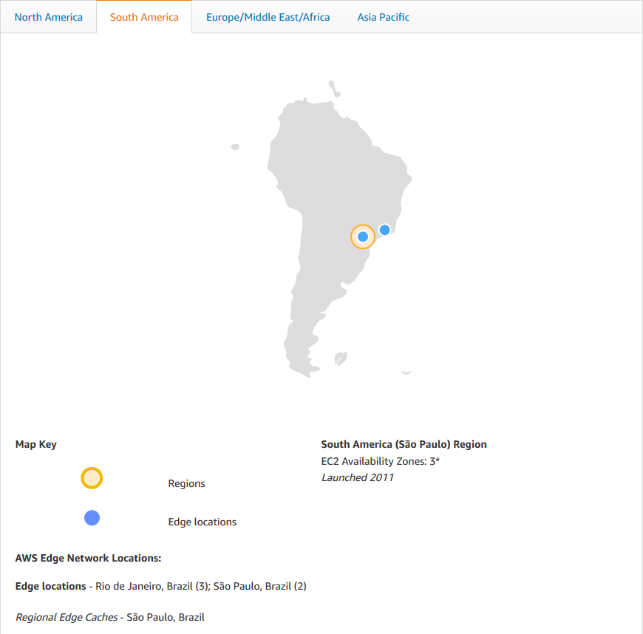
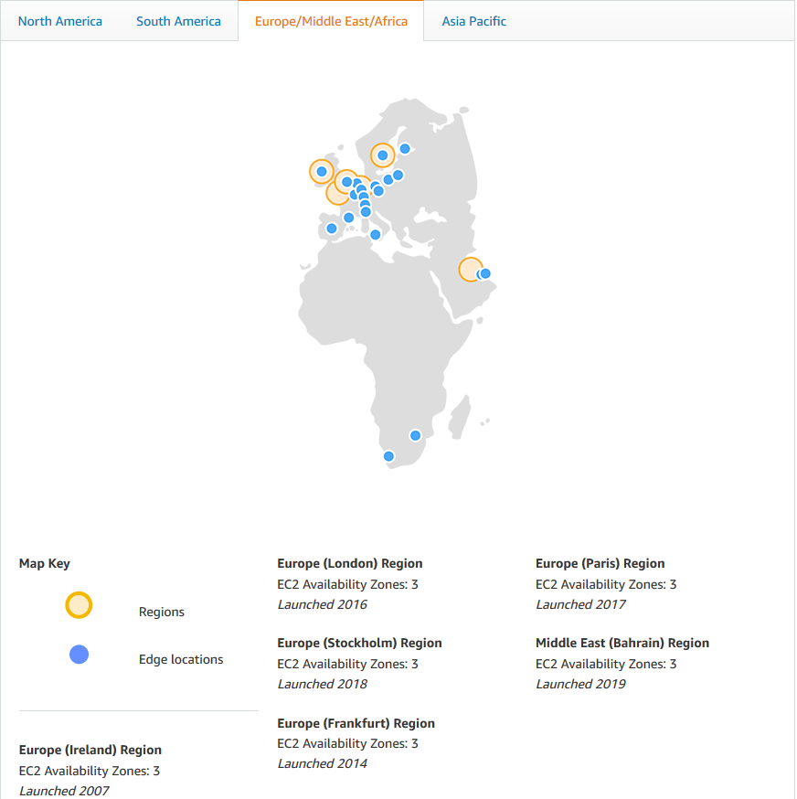
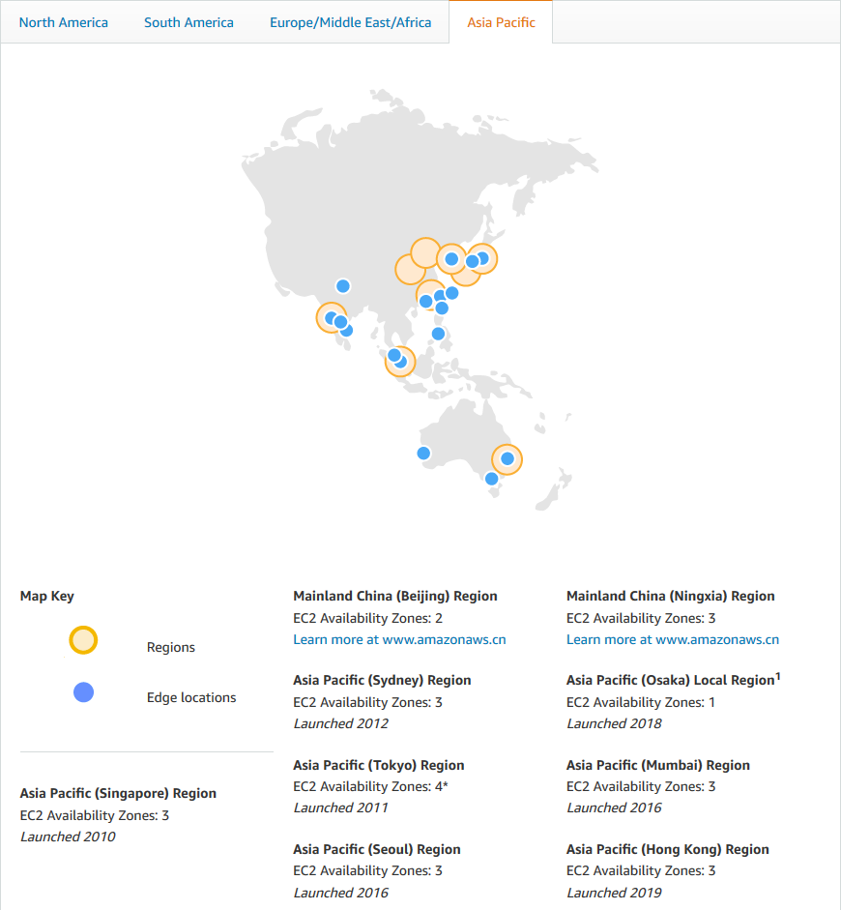
Geographical Regions and Edge Locations
Edge Locations are the same as PoPs used by CloudFront and Lambda@Edge

Slide 11
Availability Zones and Data Centres
AZ
AZ
AWS maintains 69 Availability Zones (AZ)
AZ can be multiple data centers (DC) (typically 3)
DC can have hundreds of thousands of servers
AZ fully isolated partitions of the AWS Global Region Infrastructure.
Own power
Meaningful distance from eachother (60miles apart for latency)
AZ
REGION
DC
DC
DC
AZ

Slide 12
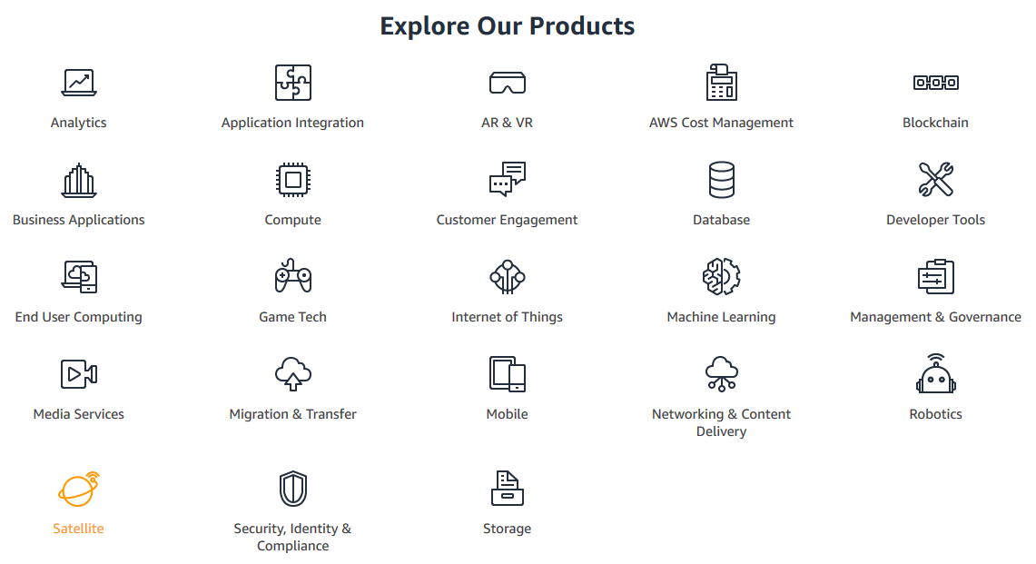
AWS Key Services
Featured Services: 23

Slide 13
AWS Key Services
Featured Services: 23

Slide 14
Traditional Computer
Router
Network
Routing
Screen
Monitor
Compute
CPU / RAM
Storage
Hard Drive
Touch Interface
Power
Electricity

Slide 15
Cloud Computing
Router
Network
Routing
Screen
Monitor
Compute
CPU / RAM
Network
Routing
Compute
CPU / RAM
Storage
Hard Drive
Storage
Hard Drive
Power
Electricity
Touch Interface
Power
Electricity

Slide 16
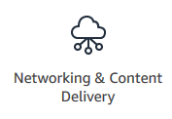
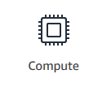
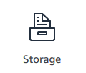
AWS Cloud Computing
Router
Network
Routing
Screen
Monitor
Compute
CPU / RAM
Network
Routing
Compute
CPU / RAM
Storage
Hard Drive
Storage
Hard Drive
Power
Electricity
Touch Interface
Power
Electricity

Slide 17
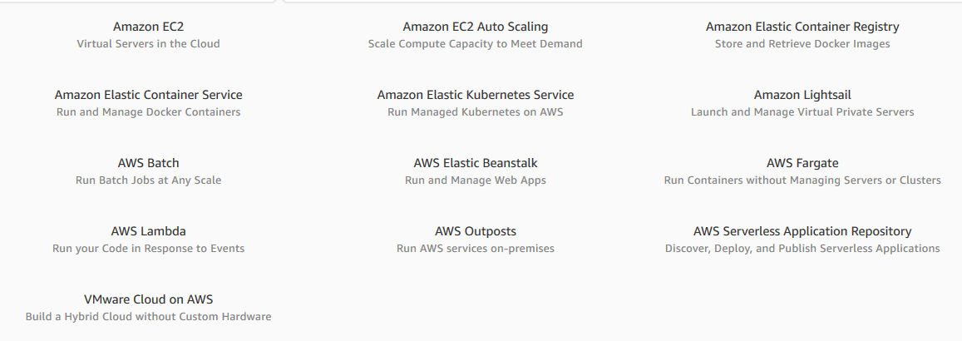
AWS Compute – Elastic Computing
Moves processing off a client machine to a data center
CPU and RAM is elastic – stretches on demand
Linked to other services to return results
Elastic Compute (EC2)
Defined AWS as a player in Cloud
10 Products based on Compute

Slide 18
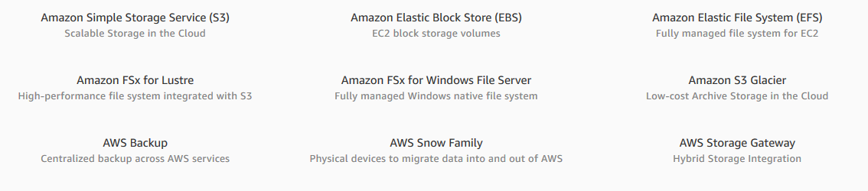
AWS Storage – S3
Moves storage off a client machine to a data center
Storage space – stretches on demand
Storage of files, separate service for databases
Simple Storage Service – S3
First AWS service in payment model
13 Products in Storage

Slide 19
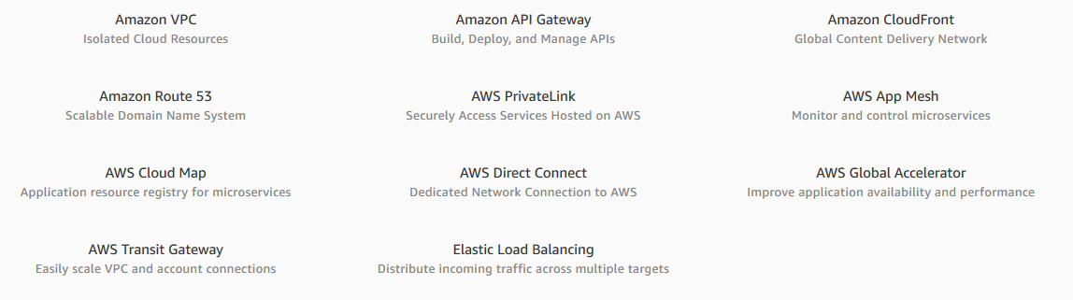
AWS Networking and Content Delivery
Manages routing and partitioning into AWS hosted resources
Forms part of security architecture
Allows for cloud hosted Virtual Private Networks (VPNs) and load balancing and CDN
Some services can be done
outside of AWS (DNS)

Slide 20
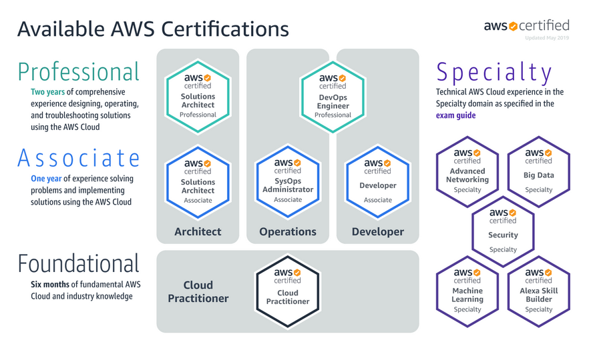
Certification: Practitioner > Architect, Operations, Developer, Specialist
3 Pathways
Architect
Operations
Developer
3 Levels
Foundational
Associate
Professional
Specialist areas

Slide 21
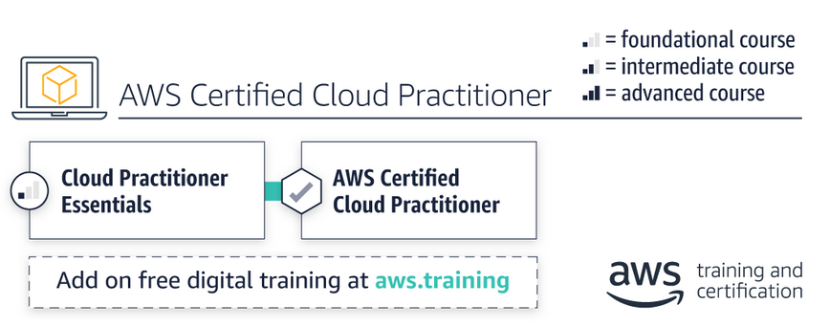
General Knowledge – AWS Cloud Practitioner
AWS Certified Cloud Practitioner
$100
Multiple choice
75 question
90 minutes

Slide 22
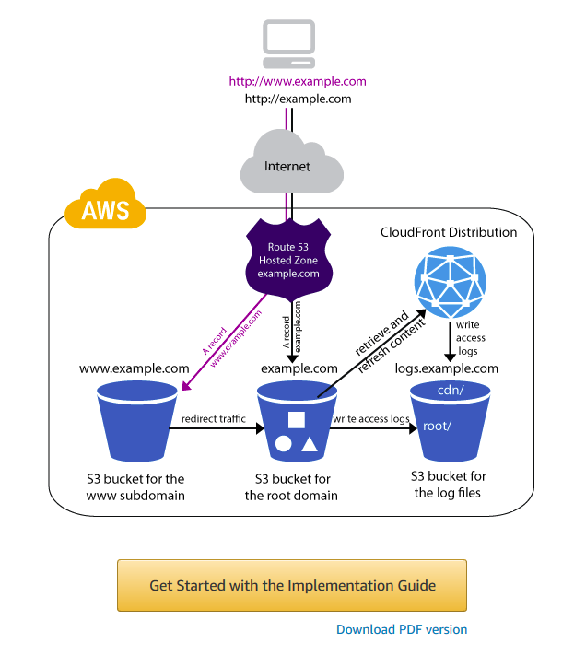
Static Website - Example
Websites on Amazon S3 » Example: Setting up a Static Website Using a Custom Domain
Example: Setting up a Static Website Using a Custom Domain
Static website – doesn’t need any computing power
Very easy to start a website – (hours)
2 AWS services
Route 53
S3
Worked example on AWS quick start guides
Level of IT knowledge
Low – basic DNS skills (the guide is far from perfect)

Slide 23
Dynamic Website - LightSail (mini AWS)
Lightsail – cutdown version/packaged of AWS core services
Easy to start a website – (hours)

